Slide 1







Slide 2
Introduction in SSIS
Bezpalyi Kyrylo
Ciklum, MSP.

Slide 3
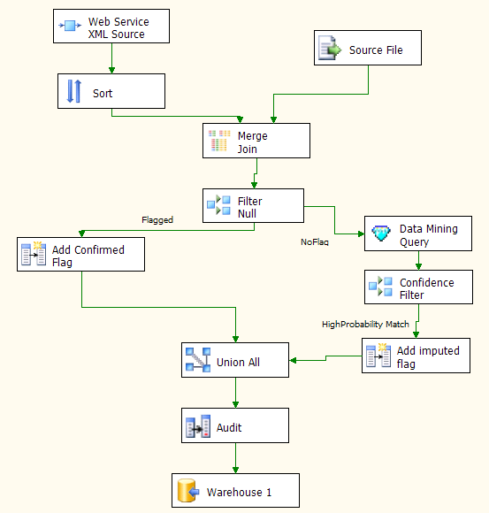
What is SQL Server Integration Services?
A Microsoft SQL Server Business Intelligence application
The successor to Data Transformation Services
The platform for a generation of high performance data integration technologies

Slide 4




How SSIS Operates
Data sources can be diverse, including custom or scripted adapters
Transformation components shape and modify data in many ways.
Data is routed by rules or error conditions for cleansing and conforming.
Flows can be as complex as your business rules, but highly concurrent.
And finally data can be loaded in parallel to many varied destinations.

Slide 5
Customer benefits of SSIS
Performance
Data flows process large volumes of data efficiently
Facility
Many prebuilt adapters and transformations reduce hand coding
Extensible object model
Highly productive visual environment
Data cleansing features
Data mining
imputation of incomplete data

Slide 6
Data Integration
Traditional data sources
XML
Custom data sources
Integrate diverse sources
Parallel loading of diverse destinations

Slide 7
Data Warehousing
Sorting and aggregation during loading
Multicast and partition
Slowly changing dimensions
Load and process Analysis Services cubes

Slide 8
Intelligent Data Handling
Capture error rows
Fuzzy lookup and grouping
Data mining on the data flow
Text mining

Slide 9
Large Data Volumes
Efficient data sources
High performance processing
Unique SQL Server Destination
> 8% faster than Bulk Insert
Advanced data flow architecture
Enables flexible concurrent processing

Slide 10

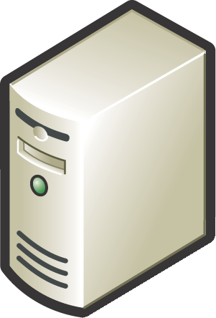

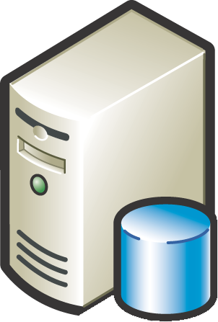




Warehouse loading with SQL Server Integration Services
SQL Server Integration Services conforms the data
But also aggregates and sorts, and loads the database
This frees-up the database server for user queries

Slide 11
Demo

Slide 12
Questions?

